Slide 1
ANCC Integration
(American Nurse Credentialing Center)

Slide 2
Introduction
The mission of the American Nurses Credentialing Center (ANCC), a subsidiary of the American Nurses Association (ANA), is to promote excellence in nursing and health care globally through credentialing programs.
ANCC's internationally renowned credentialing programs certify and recognize individual nurses in specialty practice areas.
ANCC accredits healthcare organizations that provide and approve continuing nursing education.
ANCC has been incorporated in June 1990.

Slide 3
Programs offered
Accreditation Program: It ensures the quality of nurse education program(CNE) and skills based competency programs.
Certification Program: It is to certify nurses with professional practices according to the latest nursing practice standards.
Pathway: It recognizes a healthcare organisation’s focus mainly having good practicing nursing environment, career development.

Slide 4
Magnet Recognition Program: It is the most prestigious distinction a health care organization can receive for nursing excellence and quality patient outcomes.
ISO: ANCC is the only nursing organisation to achieve ISO 9001:2008 certification

Slide 5
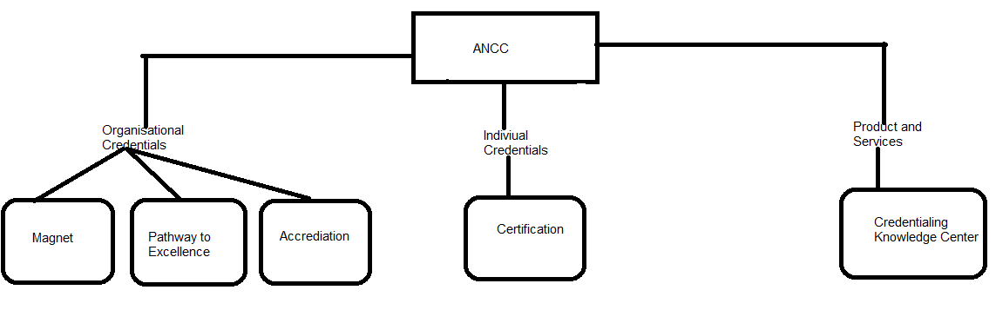
ANCC Workflow

Slide 6
History of ANCC Credentialing
In 1999, To Err is Human: Building a Safer Health System publication reported that 98,000 deaths occurred annually in the United States due to medical error.
This publication was the first in a series of IOM publications examining the quality and safety of the healthcare system (IOM, 2001; 2003; 2004a; 2004b).
A new health system for 21st century proposed 6 aims for improving healthcare that: Safe, Effective, Patient- Centered, Timely, Efficient and equitable care.

Slide 7
History of ANCC Credentialing
The IOM reports examined the complexity of the healthcare system and recognized that health professionals need new competencies—achieved and maintained through primary education and lifelong continuing education—to ensure the quality and safety of the health care delivered.
With the heightened focus on the competency of health professionals, the issue of credentialing for health professionals as a means of protecting the public is undergoing critical analysis.
Similarly, organizational credentialing has expanded over the past decade to reflect the importance of ensuring competency within a disease area (e.g., primary stroke center) or professional group.

Slide 8
ANCC as Credentialing
Total number of nurses in US are : 3,963,844.
ANCC is the largest nursing credentialing organization in the world.
ANCC offers four credentialing programs, one for individuals and three for organizations:
For individuals:
Board Certification (25 programs, including 12 in advanced practice).

Slide 9
ANCC as Credentialing
For organizations:
Magnet Recognition Program.
Pathway to Excellence recognition.
3.
Accreditation of continuing nursing education organizations.
Accreditation of courses to validate a nurse’s skills or skill sets in the clinical setting (Nursing Skills Competency Program).

Slide 10
ANCC as Credentialing
Joint accreditation for continuing education providers with the Accreditation Council for Continuing Medical Education and Accreditation Council for Pharmacy Education.

Slide 11
Forms of credentialing in the American Nurses Association’s
Licensure
Registration
Certification
Accreditation
Charter
Recognition
Approval

Slide 12
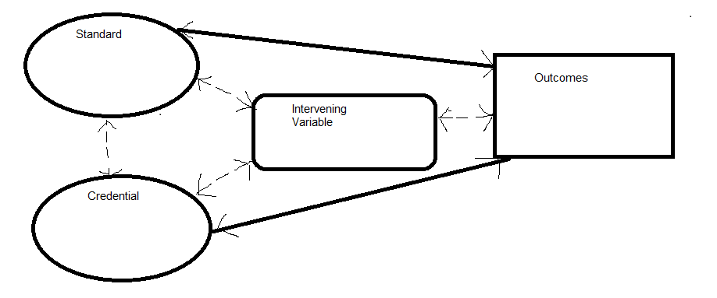
Framework for credentialing research

Slide 13
ANCC Mobile Application
ANCC app has the following specialties:
Keeping Track of Professional Development.
Storing RN License Information.
Start Initial and Renewal Application.
Tracking employees demographics, mailing lists, communication preference.

